Slide 1
Using Interactive Activities in Class

Slide 2

How can I create engaging activities to interact with the class?

Slide 3
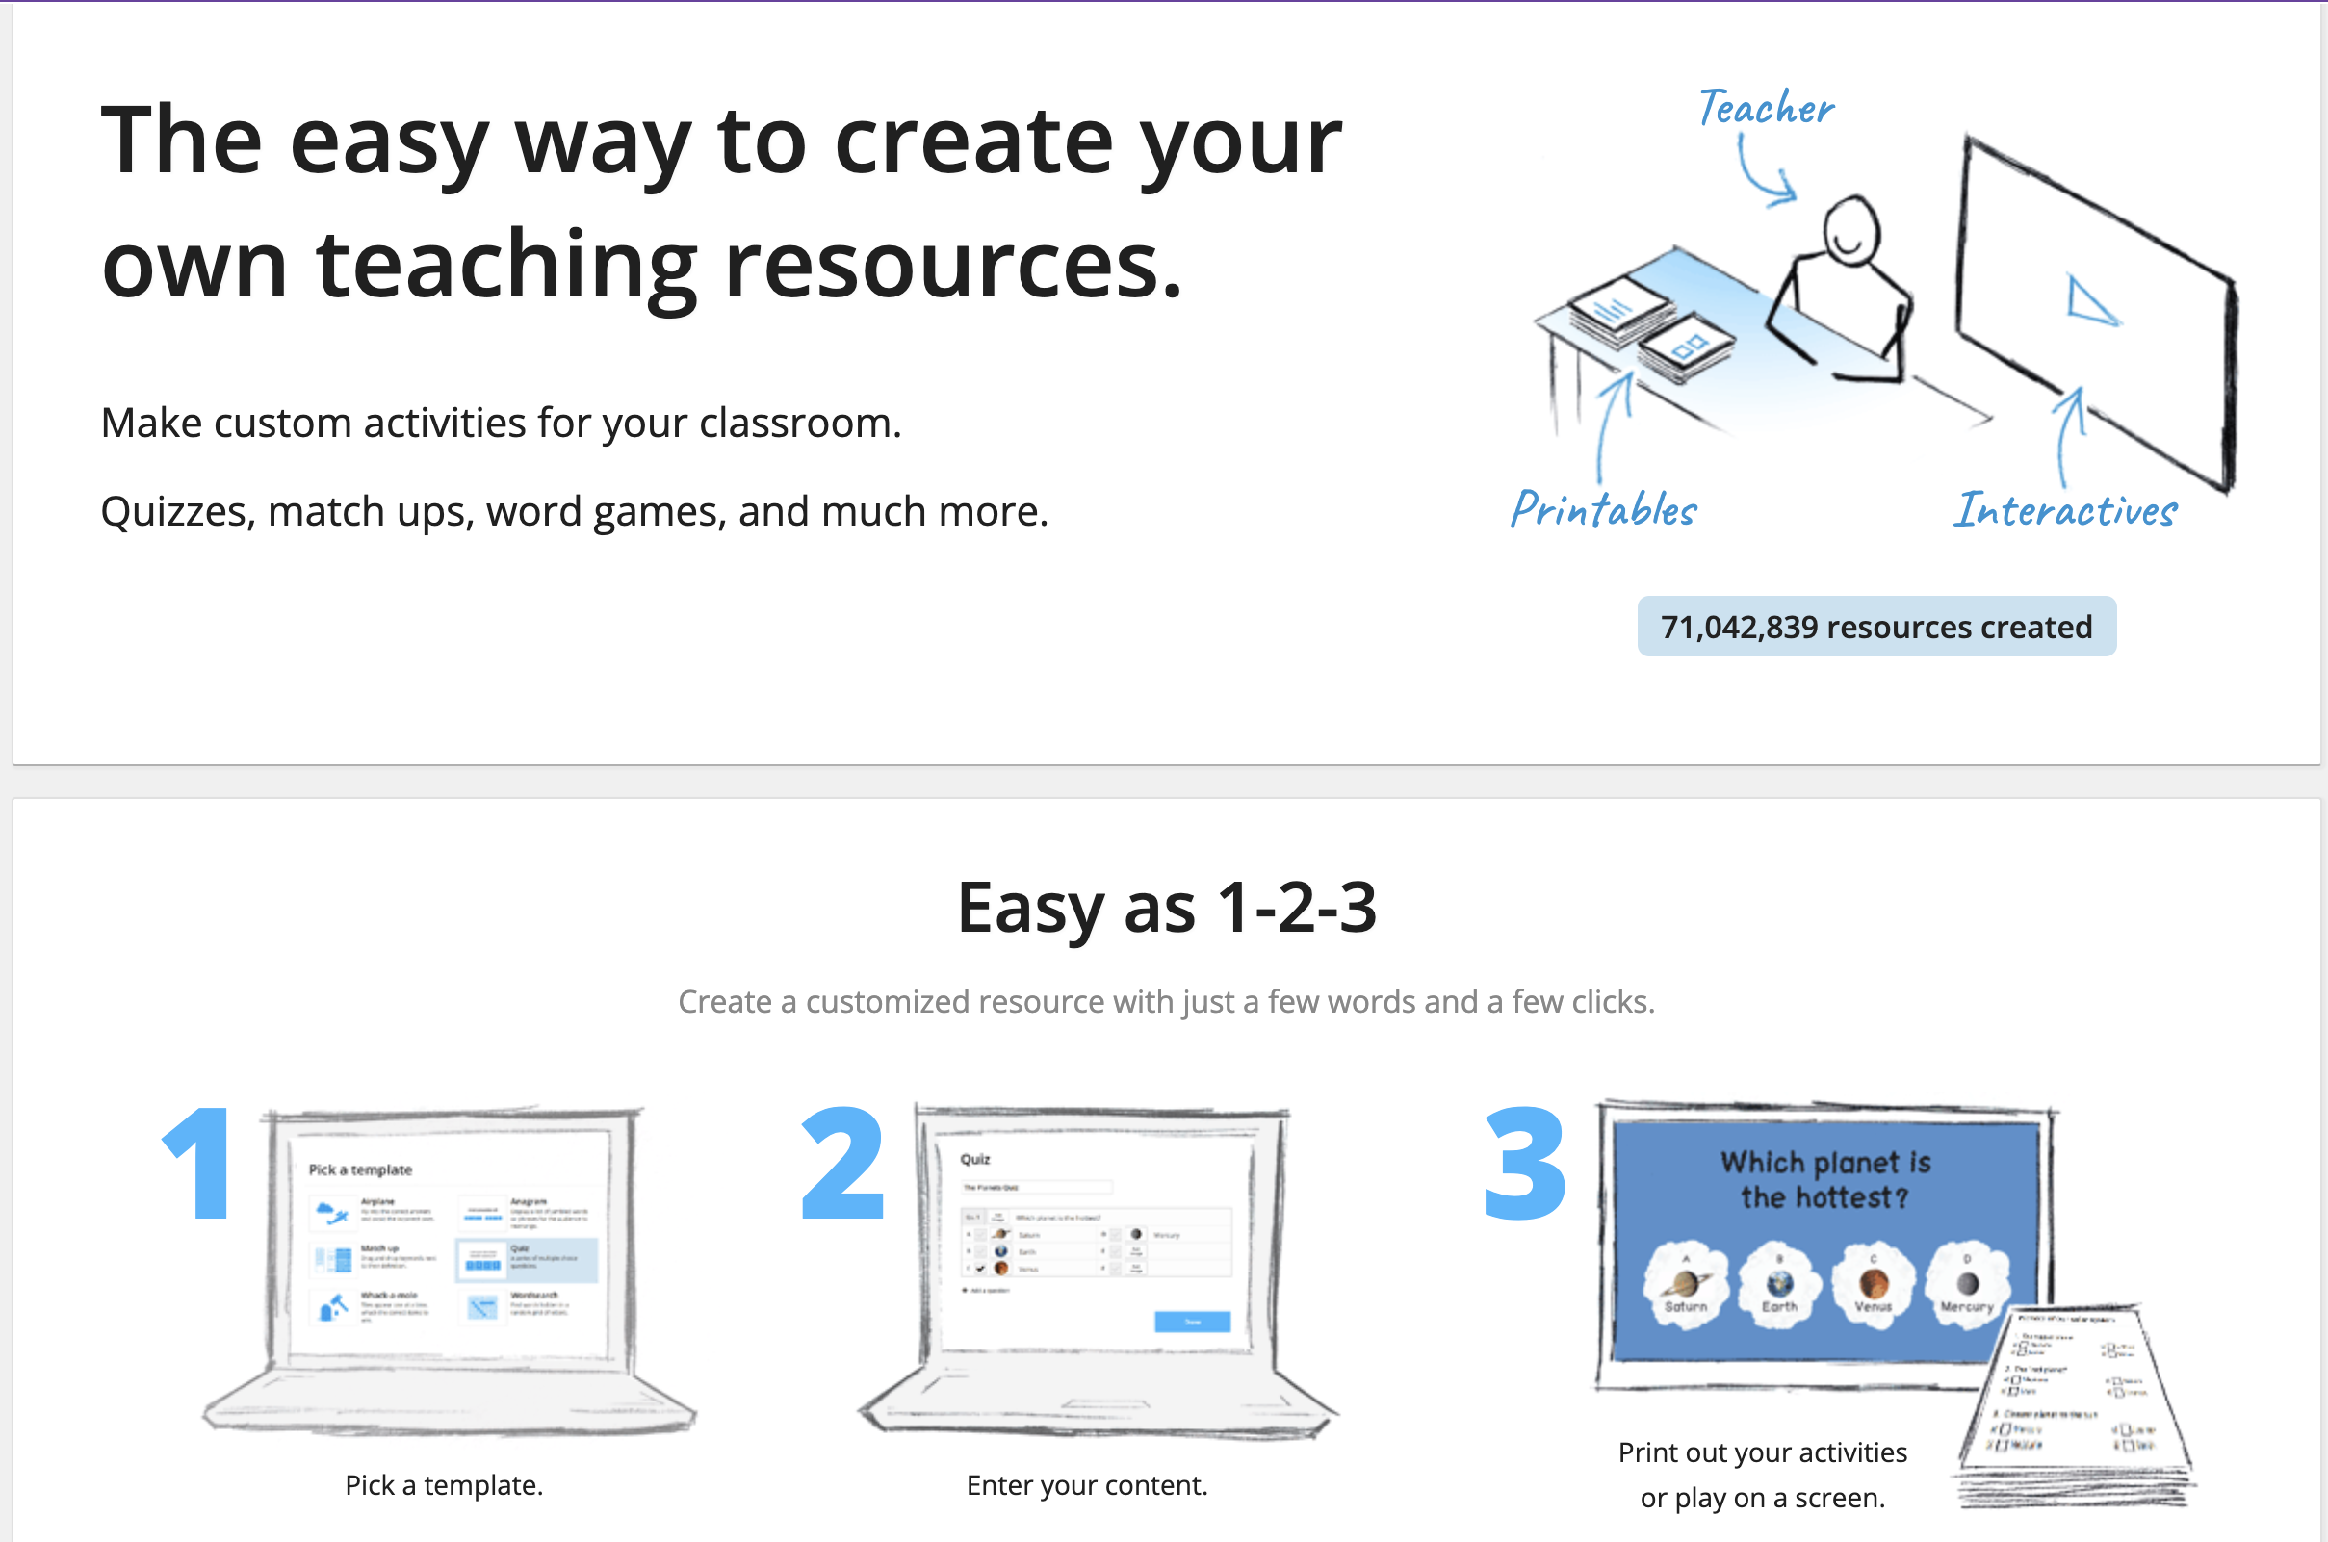
Notes:
Wordwall. “Wordwall - Create Better Lessons Quicker.” Wordwall.net, 2023, wordwall.net/.

Slide 4
How do I use it?

Slide 5

You could use it in pairs or groups.
It could be a healthy source of competition.
It is a way to get students out of their seats.

Slide 6
When do I use it?

Slide 7
It could be used as a warm-up or a cool-down activity.
You could print the templates to make quizzes or reviews.

Slide 8
What kind of activities will I find?
²

Slide 9

Matching and Memory Games
1

Slide 10
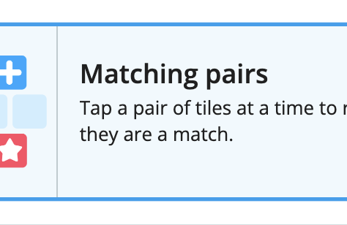
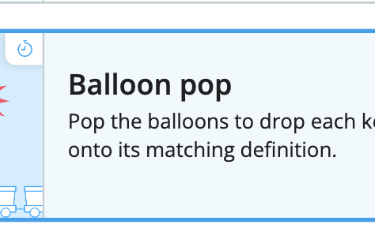
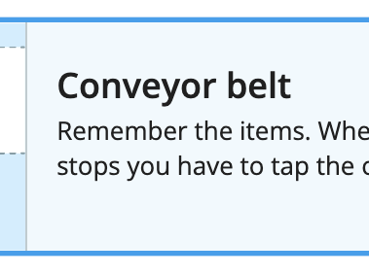
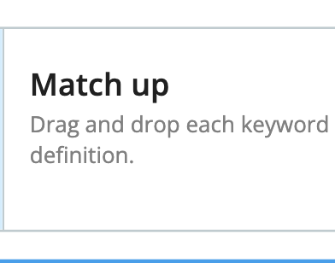
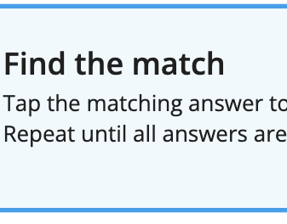
Notes:
Wordwall. “Wordwall - Create Better Lessons Quicker.” Wordwall.net, 2023, wordwall.net/.

Slide 11
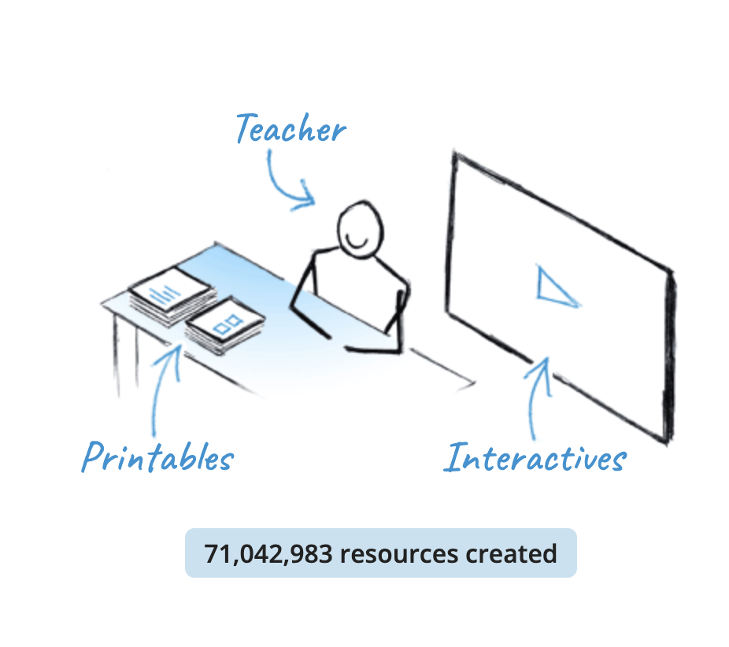
Reasons to use it
It is an easy way to engage with students.
It could improve short-term and long-term memories.
It could increase their concentration and attention span.
It could help build critical pre-reading skills.
Notes:
Wordwall. “Wordwall - Create Better Lessons Quicker.” Wordwall.net, 2023, wordwall.net/.

Slide 12
Sentence Pattern Activities
2

Slide 13
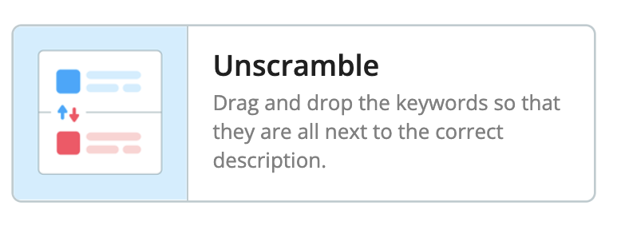
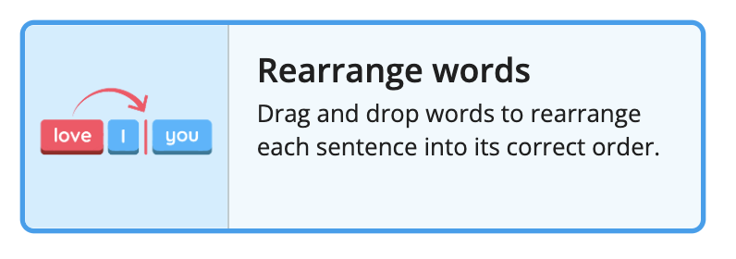
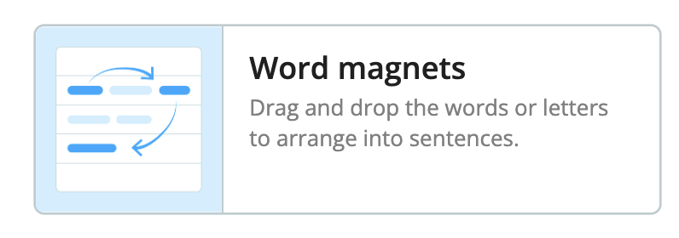
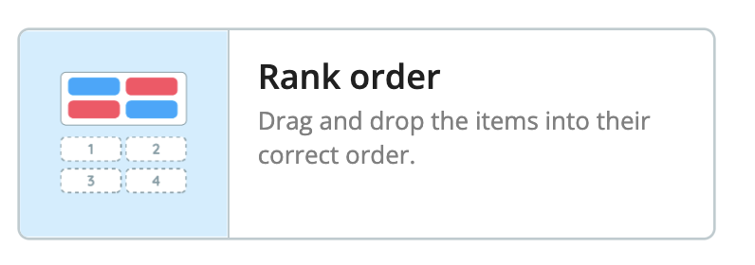
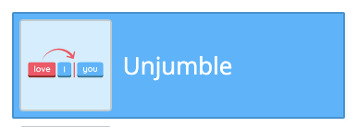
Notes:
Wordwall. “Wordwall - Create Better Lessons Quicker.” Wordwall.net, 2023, wordwall.net/.

Slide 14
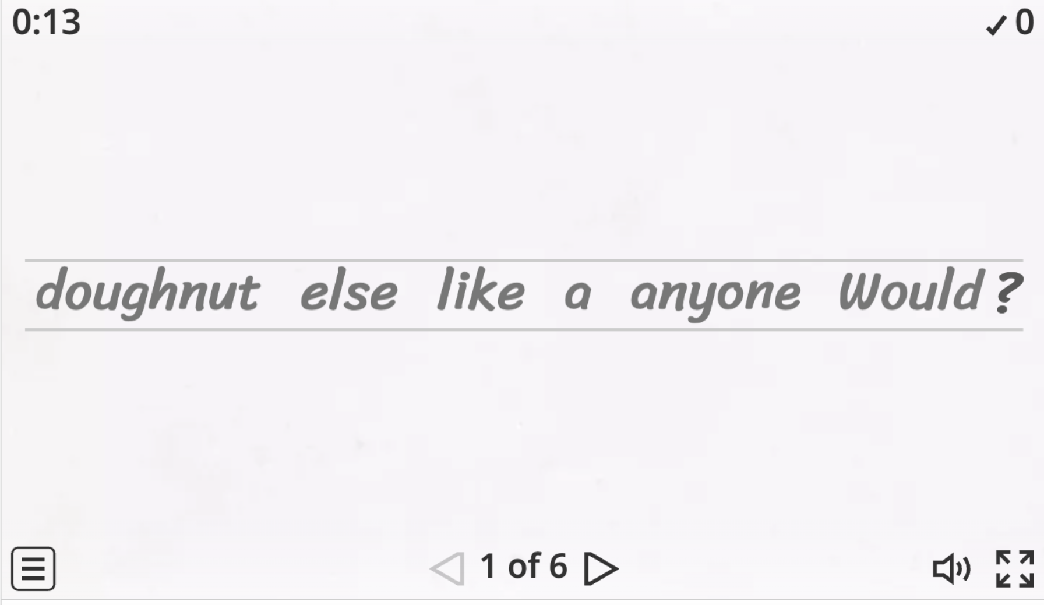
Could gain listening and comprehension skills, word fluency, and recognition.
Students could learn about sentence structure and how words are formed and fit together.
Reasons to use it

Slide 15
What are some quick and easy anchor activities?

Slide 16
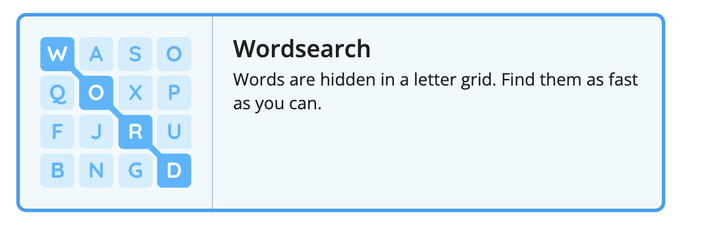
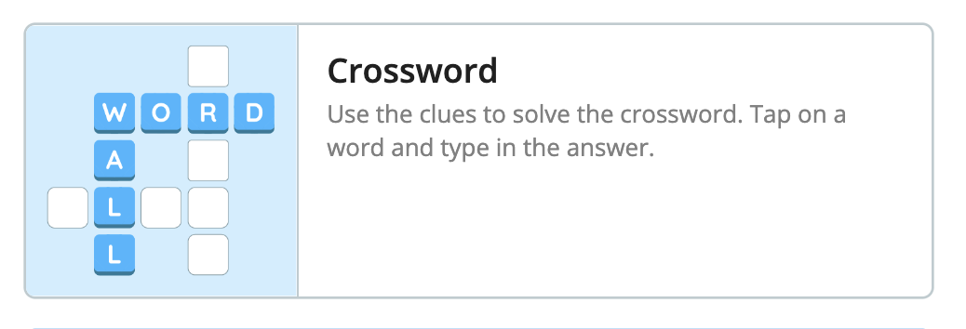
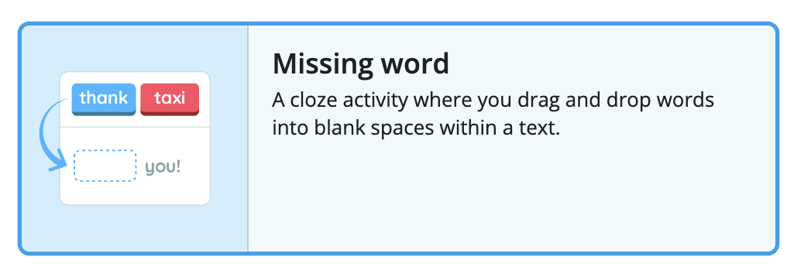
Notes:
Wordwall. “Wordwall - Create Better Lessons Quicker.” Wordwall.net, 2023, wordwall.net/.

Slide 17
Crosswords
It could allow students to evaluate their knowledge and require them to pay attention to vocabulary as they need to spell each word correctly.
Notes:
Wordwall. “Wordwall - Create Better Lessons Quicker.” Wordwall.net, 2023, wordwall.net/.

Slide 18
Missing words
Could improve language skills and comprehension through context-based word choices.
It is customizable for specific topics and grade levels, allowing for targeted vocabulary and language assessment.
Notes:
Wordwall. “Wordwall - Create Better Lessons Quicker.” Wordwall.net, 2023, wordwall.net/.

Slide 19
Word Searches
Can be used as a vocabulary activity.
Could help improve students' reading skills like scanning, decoding, and improving word recognition.
Notes:
Wordwall. “Wordwall - Create Better Lessons Quicker.” Wordwall.net, 2023, wordwall.net/.

Slide 20
How can I print templates?

Slide 21
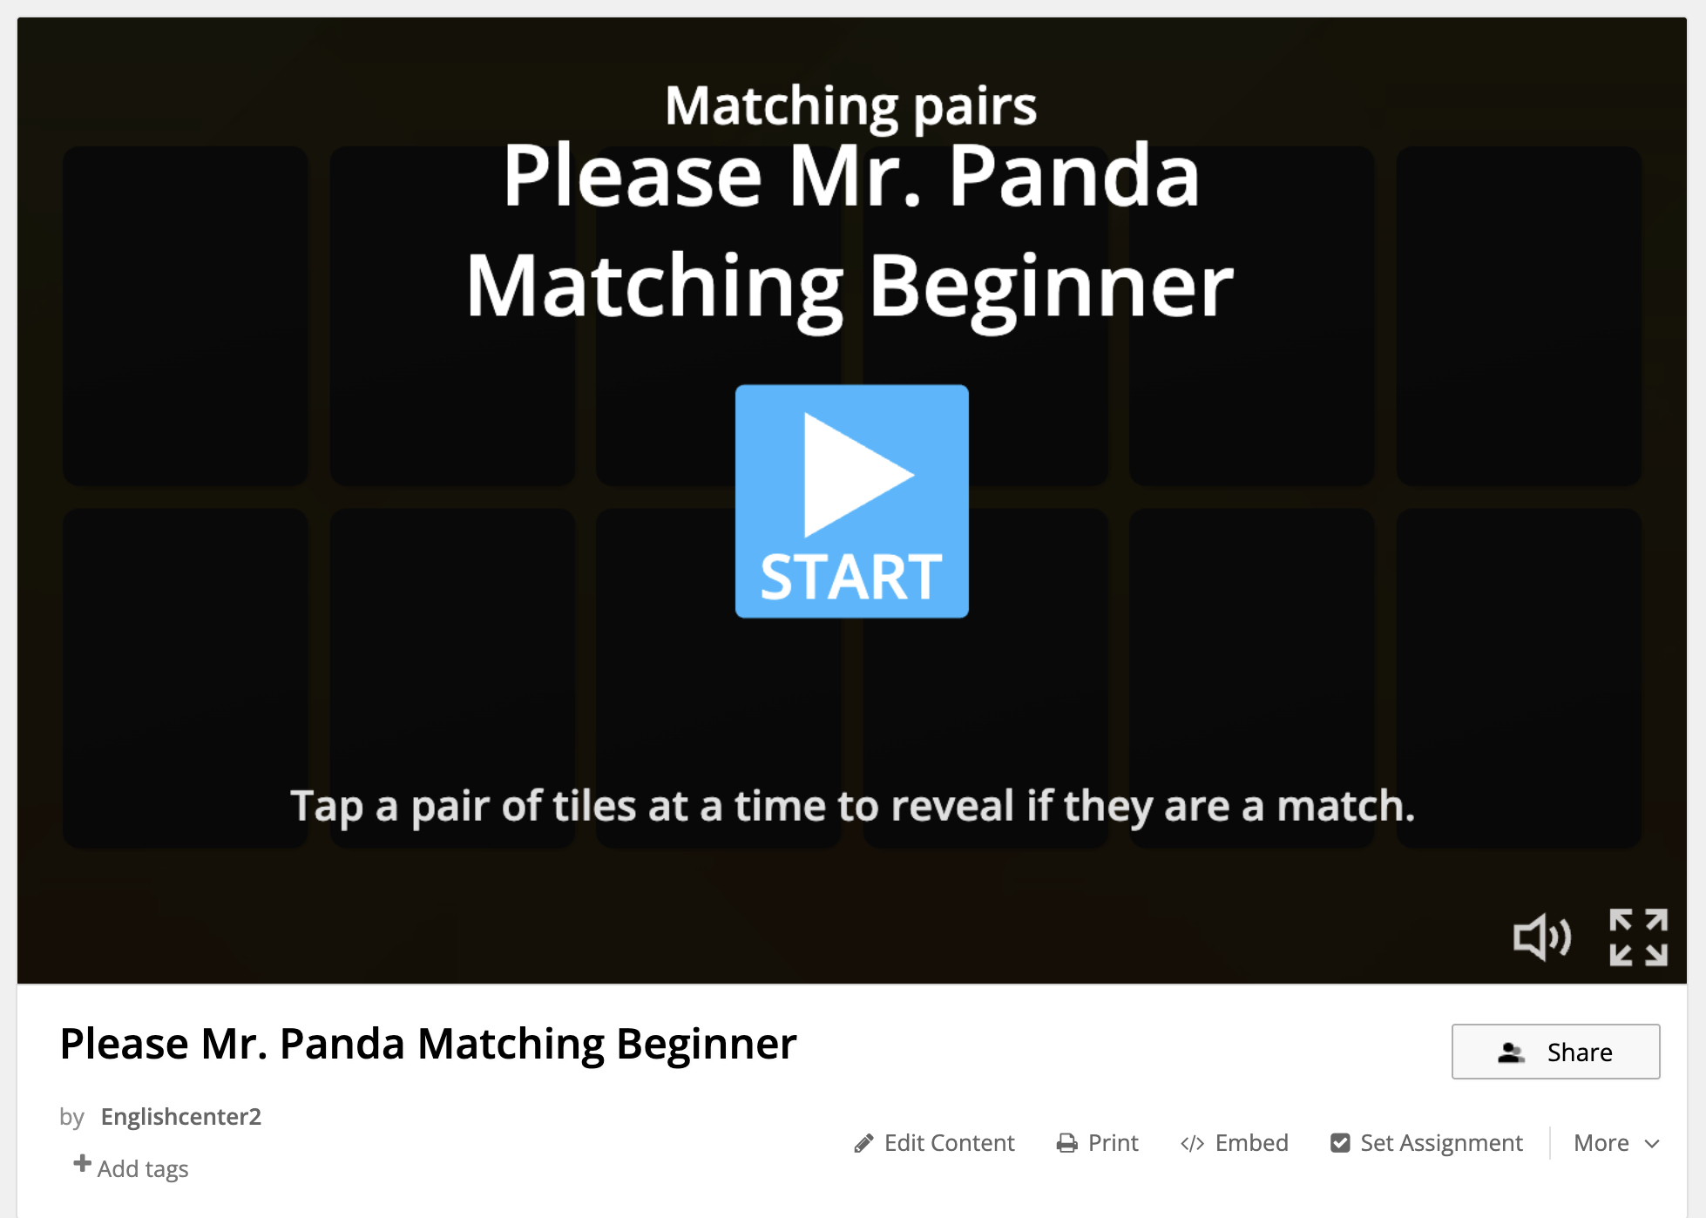

Click

Slide 22
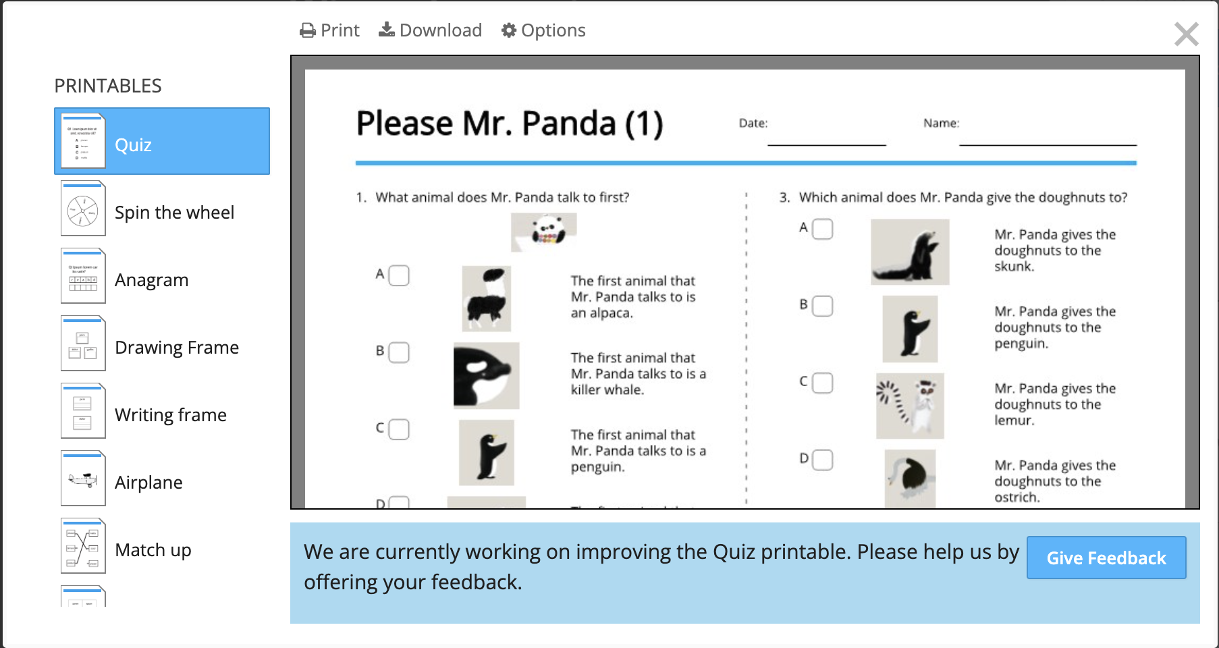
Choose

Slide 23
Click

Slide 24
What are some games students love on Wordwall?

Slide 25
